Slide 1
Agent-based Simulation Modeling for Infectious Diseases
Chaitra Gopalappa
Mechanical and Industrial Engineering
University of Massachusetts, Amherst
HackEbola@UMass, November 21-23, 2014

Slide 2
Compartmental Models (most commonly used)
Top-down approach
  Population is partitioned into as few compartments as needed
  All people in a compartment are treated alike
S
Susceptible
I
Infected
R
Recovered

Slide 3
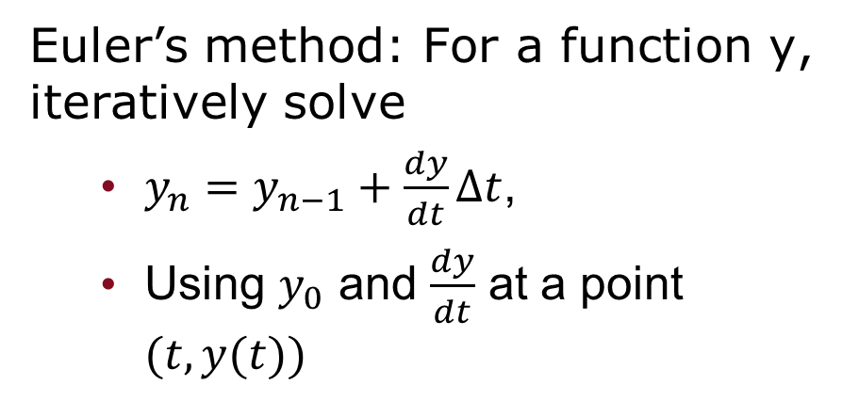
Compartmental model/ ODE
Euler’s method: For a function y, iteratively solve
  $y_{n}=y_{n−1}+\frac{dy}{dt}∆t$,
  Using $y_{0}$ and $\frac{dy}{dt}$ at a point $(t,y(t))$

Slide 4
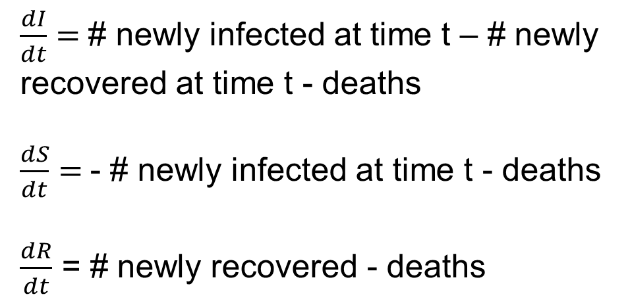
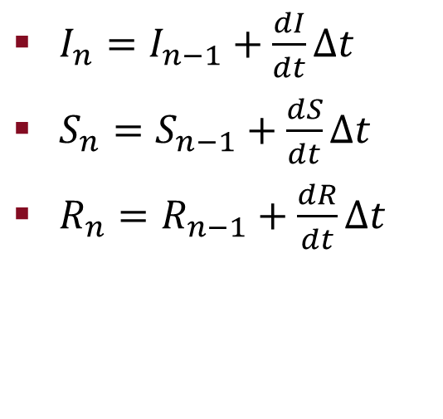
SIR model - ODEs
S
#Susceptible
I
#Infected
R
#Recovered
$\frac{dI}{dt}=$# newly infected at time t – # newly recovered at time t - deaths
$\frac{dS}{dt}=$- # newly infected at time t - deaths
$\frac{dR}{dt}$ = # newly recovered - deaths
$I_{n}=I_{n−1}+\frac{dI}{dt}∆t$
$S_{n}=S_{n−1}+\frac{dS}{dt}∆t$
$R_{n}=R_{n−1}+\frac{dR}{dt}∆t$

Slide 5
Individual agent-based simulation modeling
Bottom-up
  Simulate each person individually
  Collectively they are a population

Slide 6
Compartmental and Agent-based:
Demonstrate differences
Just for visual purpose → representing both with individual persons
But in compartmental →
  3 compartments
  all people in a particular compartment are treated alike
  Use differential equations to solve
S
Susceptible
I
Infected
R
Recovered
N

Slide 7
What are interactions?
How do we model interactions?
Agent-based Network Models

Slide 8
Question
Higher the contact rate, higher the number of infections in the population?
  true
  false

Slide 9
Sample Network Model - Facebook
Makes pictures viewable to friends of friends
A

Slide 10
Sample Network Model - Facebook
Pictures viewable to ‘friends of friends’
6 persons can view A’s pictures
A
B
Pictures viewable to friends of friends

Slide 11
Sample Network Model - Facebook
Pictures viewable to friends of friends
6 persons can view A’s pictures
4 persons can view B’s pictures
A
B
Pictures viewable to friends of friends

Slide 12
Sample Network Model - Facebook
Pictures viewable to friends of friends
6 persons can view A’s pictures
4 persons can view B’s pictures
But B and his/her friends have more friends than A
A:2
3
3
4
4
4
B:3
Pictures viewable to friends of friends

Slide 13
Thank You!
chaitrag@umass.edu

